Slide 1

Process Mining Virtual Internship
by
V. Neeraja
214G1A3267
Department of Computer Science and Engineering (Data Science)
Srinivasa Ramanujan Institute of Technology
(Affiliated to JNTUA & Approved by AICTE) (Accredited by NAAC with ‘A’ Grade & Accredited by NBA (EEE, ECE & CSE)
Rotarypuram Village, B K Samudram Mandal, Ananthapuramu – 515701.
2023 - 2024

Slide 2

Contents
Course Objective
Introduction
Types Of Process Mining
Process mining softwares
Process Mining Fundamentals
Main Stages of Process Mining
Applications of Process Mining
Benefits of process mining in Financial Services
Benefits of Process Mining in Health Care Services
Learning outcomes

Slide 3
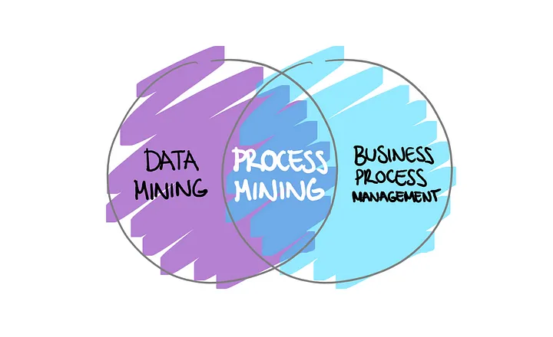
Course Objective
The course on process mining aims to provide students with the knowledge and skills to effectively analyze and enhance business processes through the use of data-driven methods.
This involves learning how to extract insights from event logs, identify process bottlenecks, deviations, and inefficiencies, and apply these findings to optimize processes for improved efficiency and effectiveness.

Slide 4
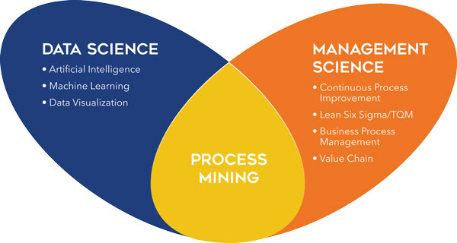
Introduction
Process Mining ?
Process mining is a technique designed to discover, monitor and improve real processes by extracting readily available knowledge from the event logs of information systems. Process Mining offers a data-driven and therefore more objective and holistic approach to understanding business processes.
Process mining should be viewed as a bridge between data science and process science. Process mining focuses on transforming event log into a meaningful representation of the process which can lead to the information of several data science and machine learning related problems.

Slide 5
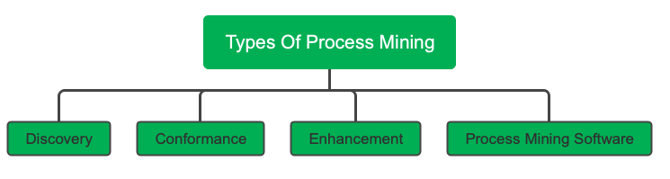
Types Of Process Mining
Discovery: Process discovery uses event log data to create a process model without outside influence. Under this classification, no previous process models would exist to inform the development of a new process model.
Conformance: Conformance checking confirms if the intended process model is reflected in practice
Enhancement: Its been referred to as extension, organizational mining, or performance mining. In this class of process mining, additional information is used to improve an existing process model.
Process Mining Software: It helps organizations analyze and visualize their business processes based on data extracted from various sources, such as transaction logs or event data.

Slide 6
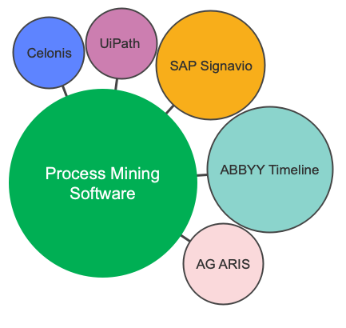
Process Mining softwares
What makes good process mining software?
Ease of use
Configurability
Analytics and reporting
End-to-end visibility (E2E)
Level of support Total cost of ownership

Slide 7
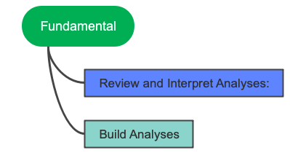
Process Mining Fundamental
Review and Interpret Analyses:
Exploratory approach:
An exploratory approach is one where you simply explore the data and see what value opportunities jump out at you. You’re diving into the data without specific expectations and with an open mind. Analysis tools such as the Process Explorer, the Variant Explorer, and the Conformance checker are ideal for this.
Confirmatory approach:
With the confirmatory approach, you’re examining the data to see if it confirms or denies a hypothesis. Using your Celonis Analysis, specifically by filtering on attributes and using drilldown tables, you can find out whether the data confirms or denies that these perceived pain points exist and have a significant impact.

Slide 8
Continue
Review Interpret Analysis
What Is Variant Explorer?
Variant Explorer allows the user to explore his process based on the end to end variants.Variant Explorer is a Celonis EMS Analysis tool that helps you explore how a specific process flows through your organization.
Process Explorer:
The Process Explorer is another analysis tool to use when taking an exploratory approach. It's especially useful for quickly revealing activities beyond the most common ones
Key Performance Indicators (KPIs) are used to calculate and add aggregated values; for example, case count, order value, invoice value, throughput time, and automation rate

Slide 9
Continue
Build Analyses
What is the Conformance checker?
Every organization has an optimal process in mind that they want to achieve. With the conformance checker, you can see how far away the organization is from reaching that goal and investigate common patterns for inefficiency. the Conformance checker to complement your efforts in interacting with the analysis visualizations and charts and tables.
Why Apply Background Filters
It's true that analysis users can apply filters when interacting with components and one of six Selection Views. But as the analysis builder, you might want to set background filters that are applied before the end user begins their analysis.

Slide 10
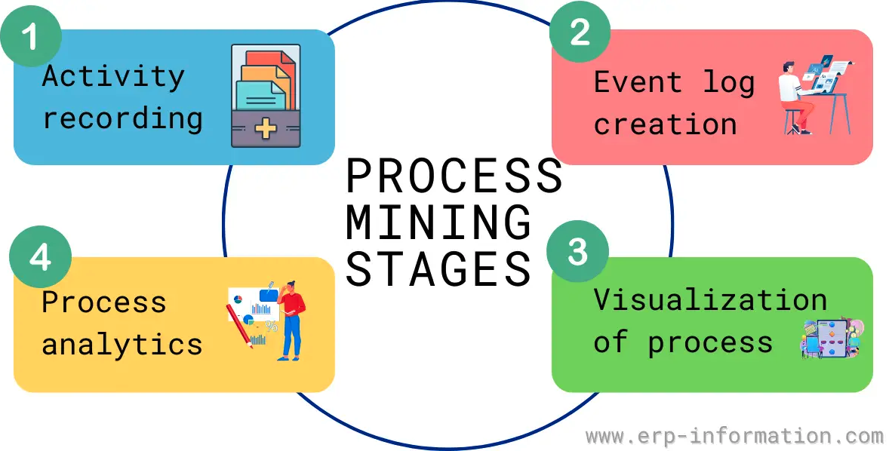
Main Stages of Process Mining

Slide 11
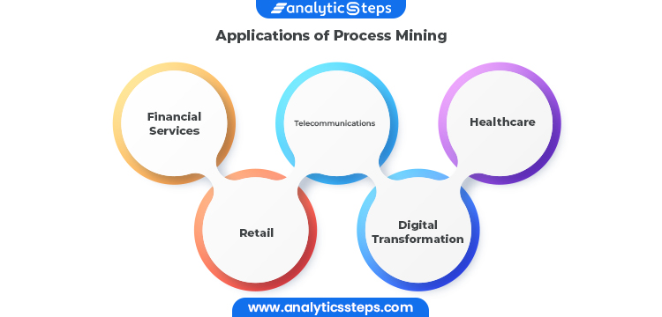
Applications Of Process Mining

Slide 12
Benefits Of Process Mining in Financial Services
Process mining can help most financial services to improve efficiency and reduce costs to better serve the needs of their customers. Some key benefits for banks and financial institutions include:
Discover and remove costly process bottlenecks.
Automatically detect fraudulent transactions.
Manage regulatory and compliance risk.
Identify automation or standardization opportunities.
Improve customer satisfaction and customer experience.

Slide 13
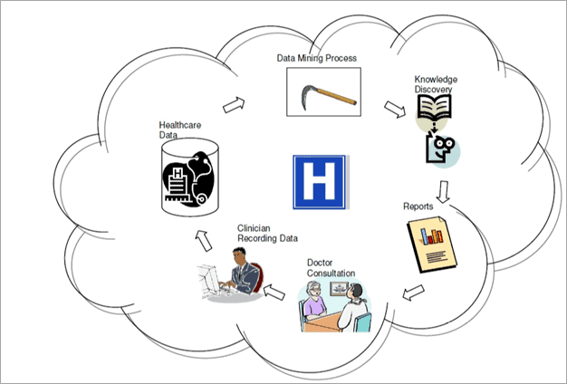
Benefits of Process Mining in Health Care Services
Identifying and understanding the real behaviour of resources and the patients.
Predicting the patient behaviour through previous cases.
Improving resource management
Analysing process performance
Increasing capabilities to meet the increasing demand
Providing insights to develop the collaboration across units and peers.
Suggesting to redesign the process.
Reducing the waiting and service time
Reducing the cost of services
Increasing process transparency
Detecting the bottlenecks in the process.
Including additional information into the activities.
Identifying decision patterns that are applied rules in different cases.

Slide 14
Learning Outcomes
Data extraction and transformation for analysis.
Techniques for automated process model generation.
Comparing actual process execution with modeled processes.
Analyzing performance metrics to identify bottlenecks.
Identifying root causes of process inefficiencies.
Predicting future process behavior using historical data.
Creating effective visualizations of process insights.
Proposing and implementing process improvements.
Applying process mining in diverse real-world scenarios.
Proficiency with process mining software tools.
Interdisciplinary skills in data analysis and management.
Using insights for strategic decisions and planning.

Slide 15
Any Queries?

Slide 16
Thank You!!!

